Slide 1
Eda – World Happiness Report 2024
A data-driven look at how India compares globally and regionally on happiness metrics.
Submitted by: Kavya Mehta
GIRD No: 11717
Course: Data Analytics Final Project
Date: 06/10/25

Slide 2
Introduction
What is EDA and Why It Matters ?
EDA (Exploratory Data Analysis) helps us understand data before modeling.
It reveals patterns, outliers, missing values, and relationships.
In this project, EDA helps uncover insights about global happiness.

Slide 3
Objectives of EDA
Project Goals
Explore global happiness distribution.
Identify key factors influencing happiness.
Compare India’s performance globally and regionally.
Highlight areas for social and policy improvement.

Slide 4
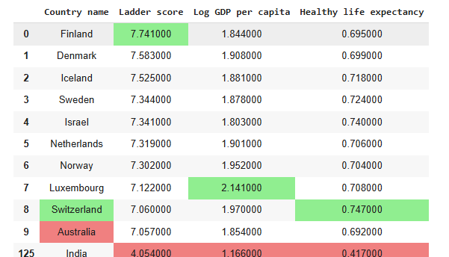
Dataset Overview
Dataset Snapshot
Covers 143 countries.
Key factors: GDP, social support, health, freedom, generosity, corruption perception.
India’s entry is highlighted for reference.

Slide 5
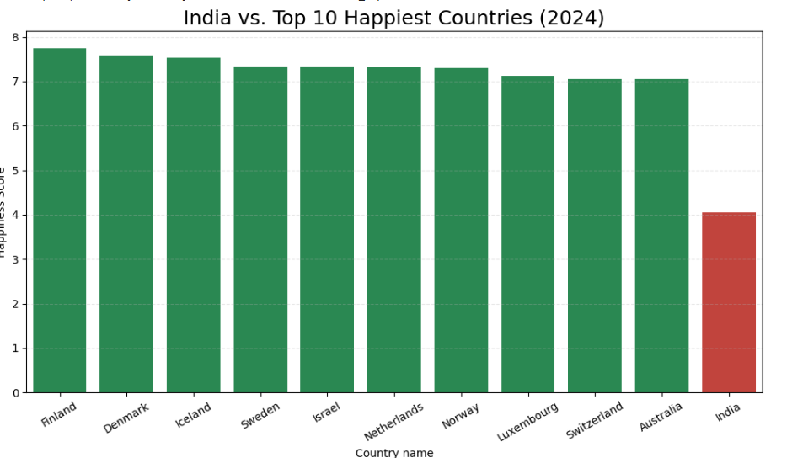
India vs Top 10 Happiest Countries
India’s happiness score compared with top 10 happiest nations.
Shows gap between India and global leaders.

Slide 6
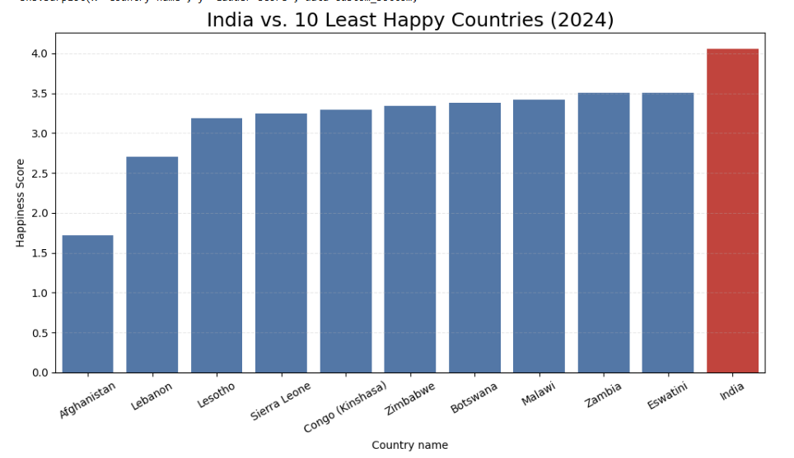
India vs Bottom 10 Least Happy Countries
India scores well above the bottom 10 countries in the World Happiness Report.
These nations often face issues like conflict, poor governance, and limited services.
While India isn’t among the least happy, it still trails behind global leaders.
There’s room to improve in areas like trust and social support.

Slide 7
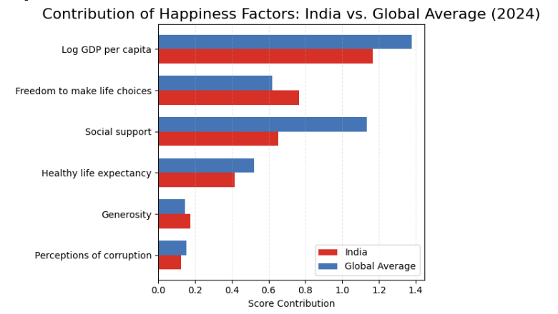
India’s Happiness Factor Scores
India’s scores across key happiness factors are mixed.
Strong areas: Freedom and generosity.
Weak areas: Social support and corruption perception.
Highlights where India leads and where it needs improvement.

Slide 8
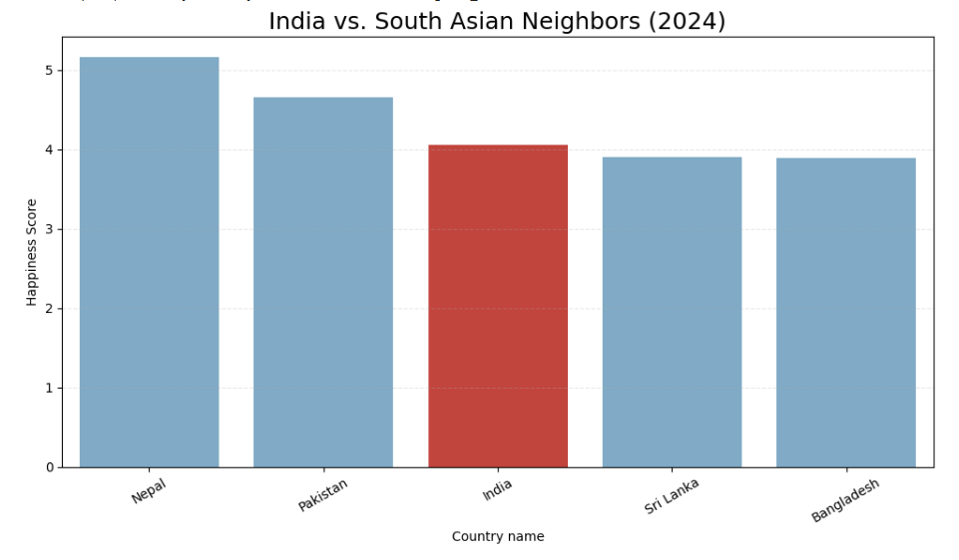
India vs South Asian Neighbors
India’s happiness score compared with nearby countries like Nepal, Bhutan, Bangladesh, Sri Lanka, and Pakistan.
Shows India’s relative position in South Asia.
India ranks ahead of some neighbors, but behind others highlighting mixed regional performance.

Slide 9
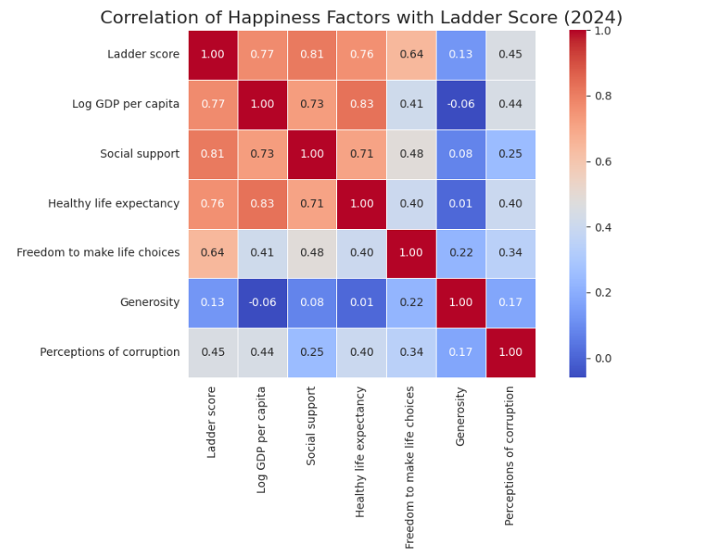
Global Correlation of Happiness Factors
Shows how strongly each factor is linked to happiness across all countries.
High correlations: GDP, health, and social support.
Weak or negative: Generosity and corruption perception.
Helps identify which areas matter most for improving happiness worldwide.

Slide 10
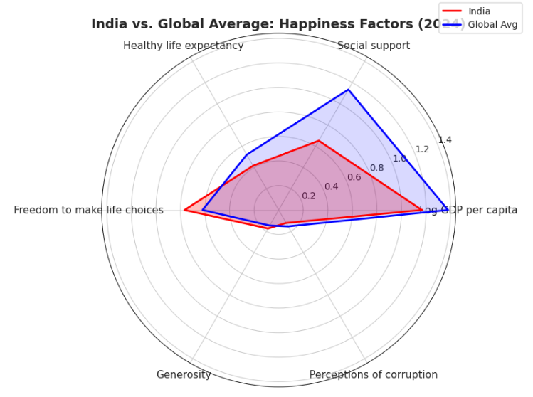
India vs Global Average (Radar Chart)
Compares India’s scores with global averages across key happiness factors.
India performs well in freedom and generosity.
Lags behind in social support and corruption perception.
Highlights areas of strength and improvement.

Slide 11
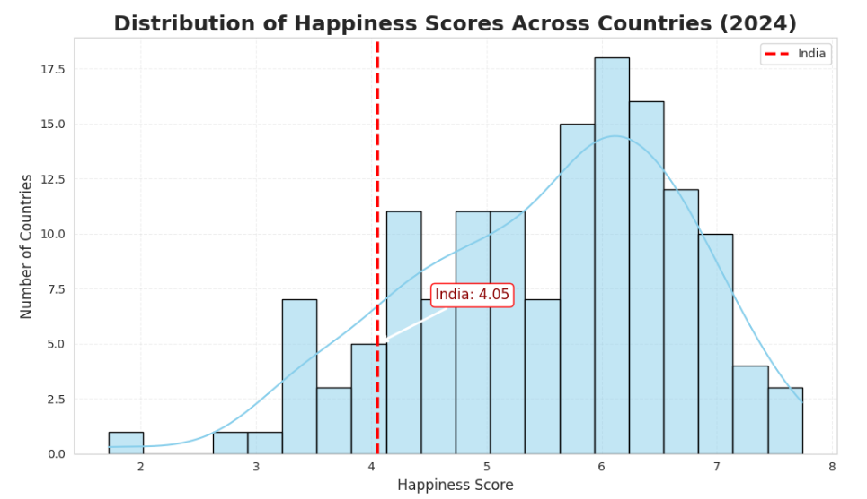
Distribution of Happiness Scores
Shows how happiness scores are spread across all countries.
India is marked in red to show its relative position.
India falls near the global average not among the happiest, but not the least happy either.

Slide 12
Key Insights & Conclusion
India ranks mid-tier in global happiness.
Strong areas: Freedom, generosity.
Weak areas: Social support, corruption perception.
Happiness is shaped by multiple factors — not just GDP.
Regional comparison shows India ahead of some neighbors, behind others.

Slide 13
References
Sources & Tools:-
Data Source: World Happiness Report 2024
Tools Used: Python (Pandas, Matplotlib, Seaborn)
Visuals created using Exploratory Data Analysis (EDA)

